Slide 1

DESIGN THINKING AND INNOVATION
CONNEX
Design Supervisor Name:Dr.N.Nanthini M.E., PhD
Name of the Student : J.Prerna,
P.Bhavya,
S.Raja Rajeswari
Register Number : 42614101,
42614102,
42614106.

Slide 2
Presentation Outline
Abstract
Introduction
Existing Availabilities
Disadvantage of existing Product
Proposed Product
Advantage of proposed Product
Design requirements
Design Diagram
Working Principle
Output Photograph
Reference

Slide 3
Abstract
Connex is a dynamic and user-centric mobile application designed to bridge the gap between volunteers, service providers, and those in need. It serves as a comprehensive platform to connect individuals and organizations interested in community service and social impact initiatives. The app facilitates the discovery, coordination, and management of community service opportunities, making it easier for users to engage in meaningful acts of service and contribute to their communities.
In a rapidly evolving digital age, where individuals are increasingly seeking opportunities to make meaningful contributions to society, this app serves as a powerful catalyst for connecting volunteers, service providers, and community members. The app leverages technology to address real-world challenges and facilitate a wide range of service opportunities, enabling users to bridge the gap between those in need and those willing to help.
In an era of increased isolation and disconnectedness, the Connex app serves as a bridge that connects individuals with shared values and a passion for giving back. By leveraging technology to facilitate community service, this app not only addresses societal needs but also promotes a sense of belonging, a culture of compassion, and a vision for a brighter and more inclusive future. This app is more than just a digital platform; it's a movement, a hub of hope, and a testament to the power of community.

Slide 4
Introduction
An innovative approach to a community service app involves infusing it with elements of gamification, turning the act of volunteering into an engaging and rewarding experience. The gamified version of the community service app reimagines traditional volunteering by incorporating elements such as points, badges, leader-boards, and interactive challenges.
Users are encouraged to participate in community service activities, complete tasks, and earn rewards, creating a sense of achievement and competition. Gamification not only enhances user engagement but also increases commitment to service projects, motivating users to make a consistent and impactful contribution to their communities.
By turning volunteering into a dynamic and interactive experience, this gamified app not only fosters a sense of community but also drives positive change, making volunteerism more accessible and enjoyable for a wider audience. This innovative approach harnesses the power of gamification to transform the way people engage with community service, making it more fun, competitive, and ultimately, more impactful.

Slide 5
EXISTING AVAILABILITIES
Several community service apps are available to connect users with volunteer opportunities, nonprofit organizations, and causes they are passionate about.
Platforms like VolunteerMatch, GiveGab, and Serve.gov enable users to search for volunteer opportunities in the United States across various sectors, from education to disaster relief. Points of Light offers a database of volunteer opportunities and valuable resources, while Idealist focuses on connecting users with nonprofit jobs and internships. Additionally, apps like All for Good, UN Volunteers, and Cheerful Giving provide diverse platforms for discovering volunteer opportunities, including international roles and donation options.
These apps facilitate community service, making it more accessible and engaging for users, allowing them to explore opportunities, track their contributions, and connect with like-minded individuals who share a commitment to positive change.

Slide 6
Disadvantages of the existing Product
VolunteerMatch is a great tool for finding volunteer opportunities, but it has some limitations to keep in mind. It mostly concentrates on the United States, so if you're outside the U.S. or in an area with fewer volunteer options, it might not be as useful.
Popular roles can be competitive, making it harder to get those positions. Users may find it challenging to secure these positions, especially when they are in high demand.
VolunteerMatch's skill-based matching may not cover highly specialized skills, which could be a drawback for individuals with unique expertise.
Some opportunities listed might not be active, and there could be privacy concerns for some users. For those seeking international opportunities, specialized roles, or alternatives that address these limitations, exploring other community service apps might be beneficial.

Slide 7
Proposed Product
The ‘Connex’ app is all about simplifying volunteering and giving back. Users can easily discover volunteer opportunities that match their interests, from environmental causes to education. The app helps them sign up for these events, track their service hours, and even create reports for school or personal use. It also has a donation feature, making it effortless for users to support causes they care about. To make the volunteering experience even more exciting, users earn points for their activities and donations, which can be redeemed for rewards.
The app is not just about doing good but also learning and connecting. Users can access educational content on social issues and personal development, and they can join forums and groups to connect with others who share their passion for making a positive impact. With features like event management, notifications, and feedback options, this app is designed to be an all-in-one platform for accessible, engaging, and rewarding volunteering.

Slide 8
Advantages of the proposed product
With gamification elements like points, badges, and leaderboards, users can earn rewards and compete with others, making volunteering feel like a game. They can share their volunteer activities on social media, inspiring their friends to get involved too.
The app can also recommend personalized volunteer opportunities based on users' interests and skills. Users can track their service hours and generate reports, which is great for students and building a volunteer portfolio.
Plus, they can see the impact they're making, which motivates them to keep giving back. And features like event management, community forums, notifications, donation integration, and feedback options to make the app even more awesome.

Slide 9
Design Requirements
HARDWARE REQUIREMENTS:
1.Computer: A capable PC or Mac is essential, ensuring smooth app development by running necessary software effectively.
2.Smartphone or Tablet: Testing on your device is crucial to assess app performance and ensure compatibility with various screens and OS versions.
3.Reliable Internet Connection: A dependable internet connection is vital for downloading SDKs, libraries, and accessing online development resources.
4.SDKs and Tools: Choose the appropriate SDKs and tools for your platform (iOS, Android, etc.) to provide essential frameworks and APIs for app creation.
5.Storage Space: Sufficient storage on your computer is needed to store project files, libraries, and resources during app development.
6.Compatible OS: Ensure your computer runs a compatible operating system (Windows, macOS, Linux) meeting the requirements of your target platform.
7.Additional Peripherals: While optional, peripherals like a keyboard, mouse, and external monitor can enhance productivity and comfort during coding.

Slide 10
SOFTWARE REQUIREMENTS:
Operating Systems:
Windows, macOS, Linux for development and testing.
iOS and Android for mobile app development.
User Interface (UI) Design:
Design software like Adobe XD, Sketch, or InVision for creating mockups and user interfaces.
Bootstrap or other CSS frameworks for creating responsive web layouts.
Mobile Development Tools:
Android Studio and Xcode for app development.
MySQL or MongoDB for data storage.
Python, HTML (Hypertext Markup Language), PHP for building the server-side logic.
For web development: Visual Studio Code, Sublime Text, or any preferred code editor.
Security Tools and Libraries:
Use security libraries and tools for encryption, secure coding practices, and protecting user data.
Notification Services:
Use push notification services (e.g., Firebase Cloud Messaging, Apple Push Notification Service) for sending alerts and reminders.
Payment Gateway Integration:
Integrate payment gateways like Stripe or PayPal for transactions and donations.

Slide 11
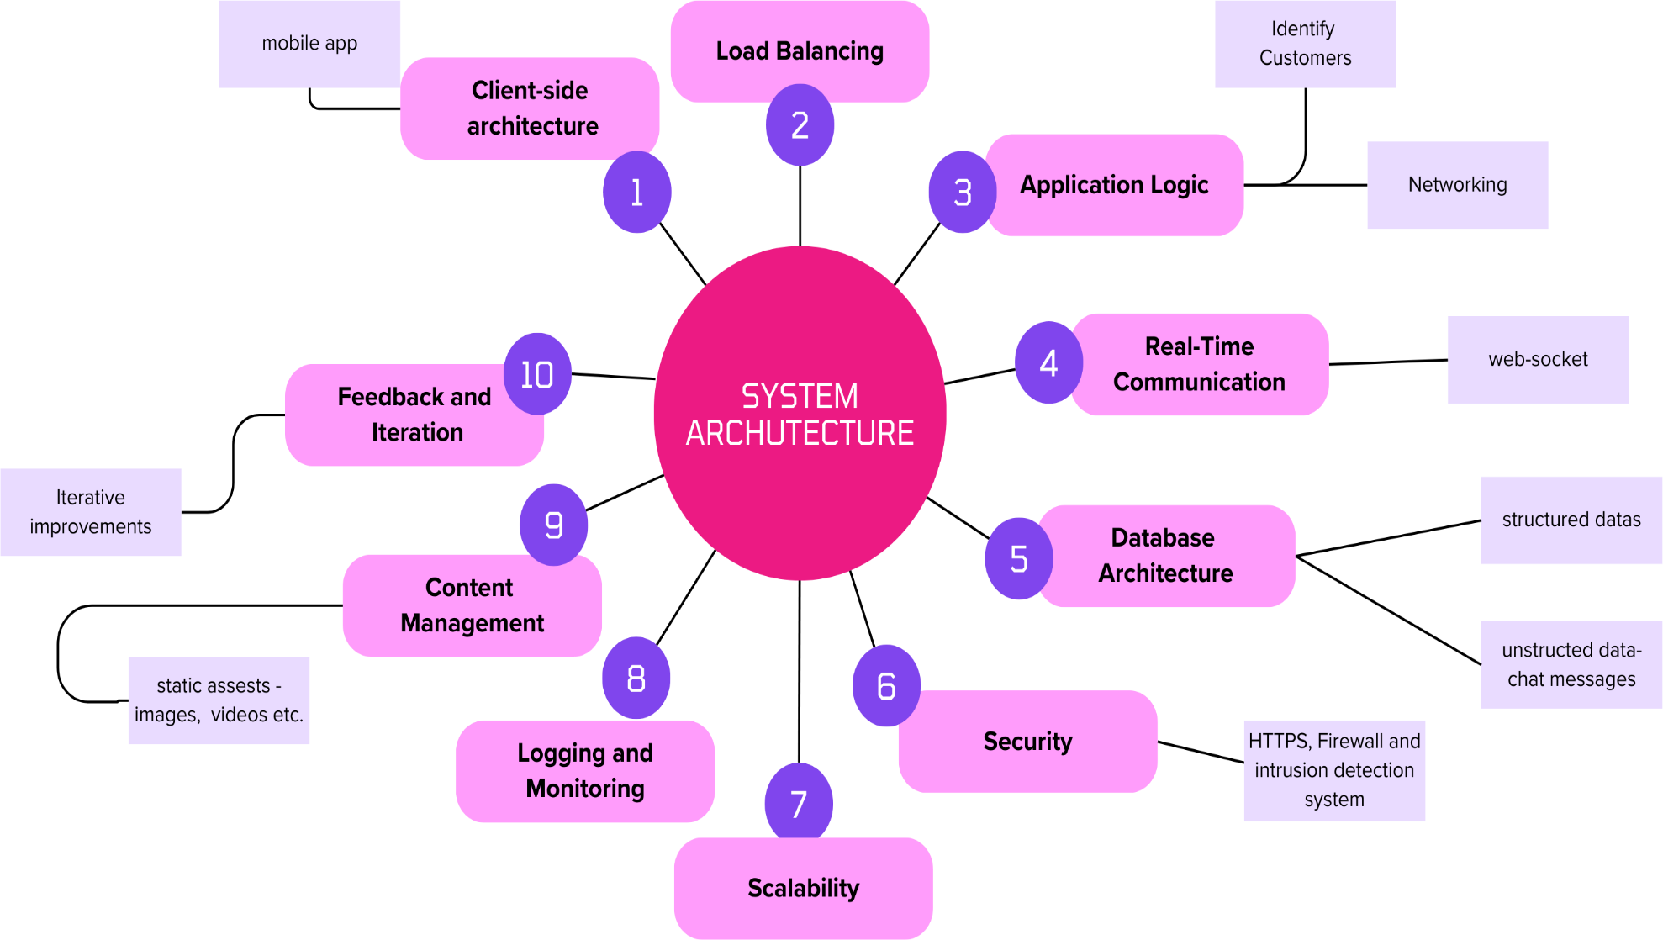
Design diagram

Slide 12
Working principle
User Registration and Profiles : Users sign up, create profiles with personal info, interests, skills, and past volunteer experience for improved opportunity matching..
Volunteer Opportunity Listings: The app features a vast volunteer opportunity database where organizations submit events with key details. Users can efficiently browse and filter opportunities based on their preferences for a tailored experience.
Donation Platform: The app streamlines donations through a secure gateway, allowing users to choose causes, specify amounts, and select preferred payment methods. Stringent data privacy measures are in place to safeguard financial transactions.
Event Management and RSVPs: The app facilitates event management, enabling RSVPs for users and providing organizers with estimated attendance data, while also sending timely reminders. Organizers can efficiently oversee attendance and manage event logistics.
Community Engagement: The app encourages a vibrant community by facilitating user connections, experience sharing, and feedback on events through discussion forums, chat tools, and a social media-like feed for updates and stories.
Analytics and Reporting: The app gathers user engagement data and donation trends, helping to understand user behavior, enhance effectiveness, and generate detailed impact reports for organizations.

Slide 13
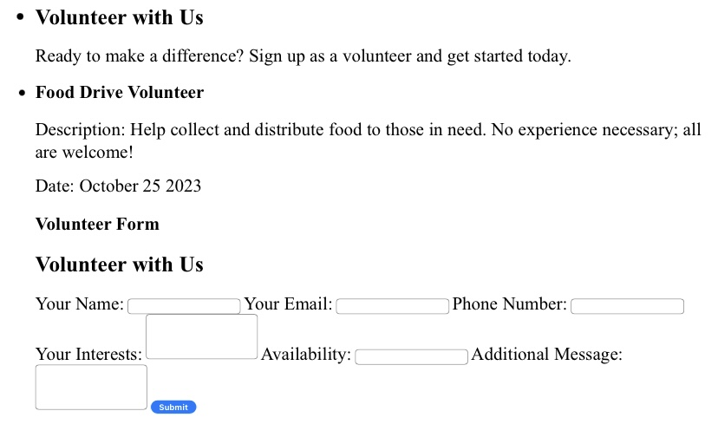
Output photograph(3D)

Slide 14
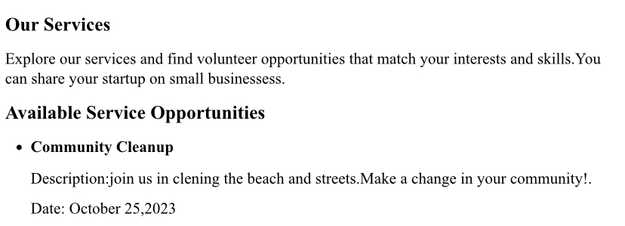
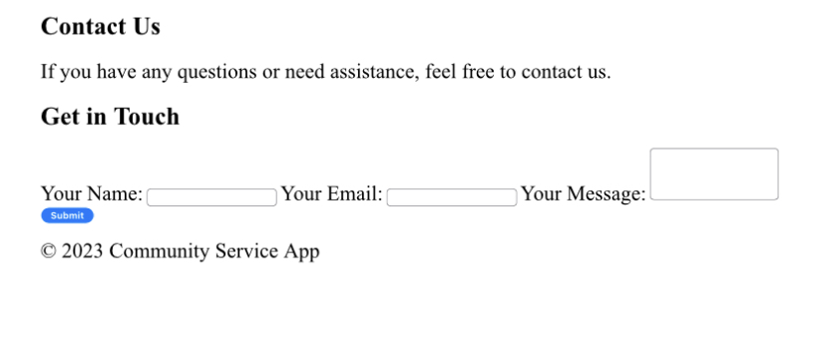

Slide 15
Reference
https://www.researchgate.net/publication/342749037_The_Impact_of_Community Service Learning on the Social Skills of Students.
An Example for Industry 4.0: Design and Implementation of a Mobile App for Industrial Surveillance Based on Cloud | IEEE Conference Publication | IEEE Xplore.
https://nextdoor.com/.
http://mecs-press.org/ijitcs/ijitcs-v7-n10/IJITCS-V7-N10-5.
VolunteerMatch - Where Volunteering Begins
https://www.volunteermatch.org/

Slide 16

THANK YOU

